Slide 1
WAWA-HCL HACKATHON

Slide 2
OUR APPROACH
Data Interpretation
04
Trend, Seasonality and Pattern Recognition
01
Data Exploration
Predictive Analytics
Anomaly Detection and Outlier testing
03
Data Enrichment
Data Modelling, Forecasting and Regression
02
External factor affecting the trend

Slide 3
PREDICTIVE ANALYTICS
PATTERN-
RECOGNITION
REGRESSION
FORECASTING

Slide 4
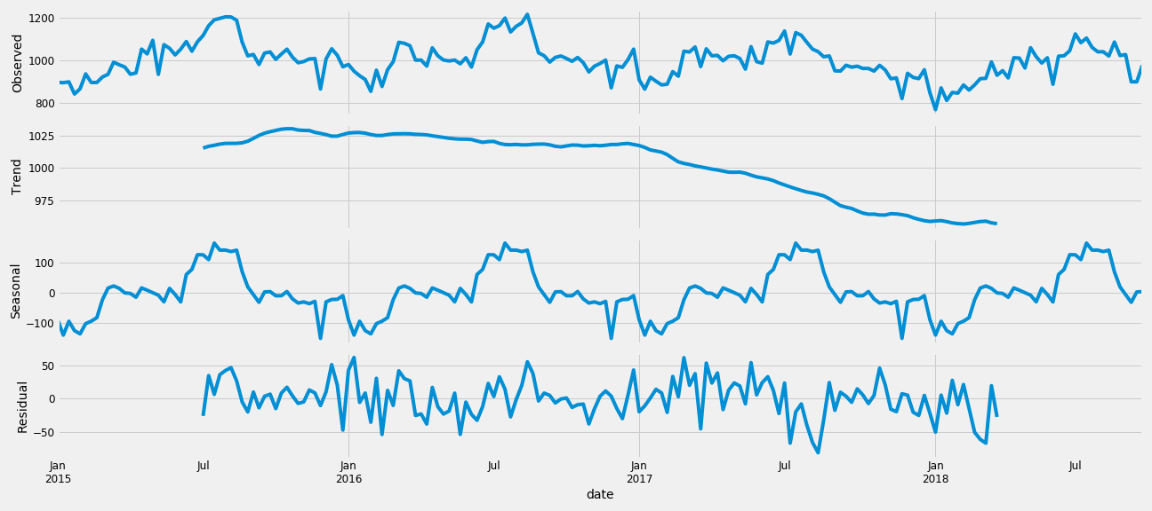
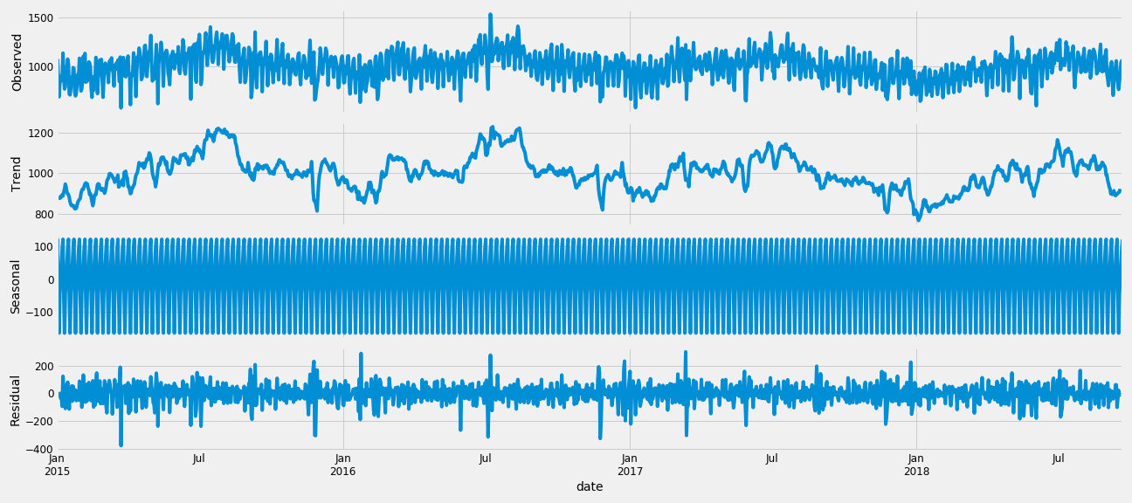

Slide 5
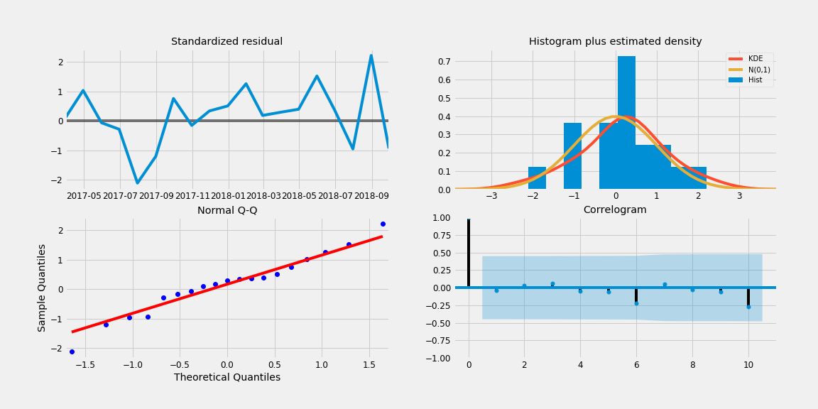

Slide 6
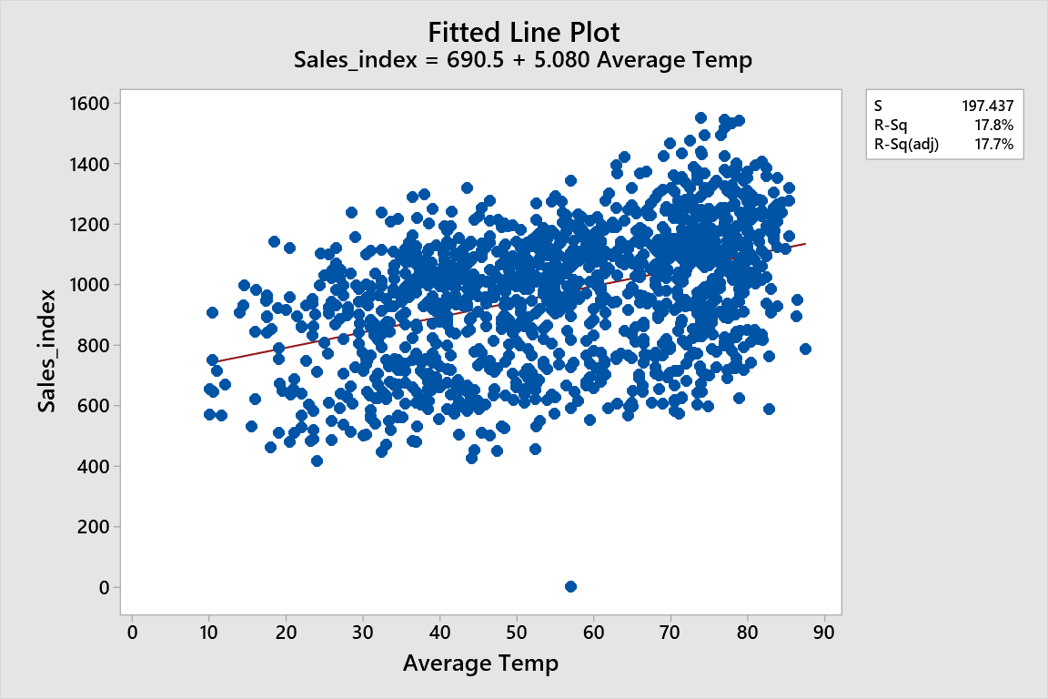
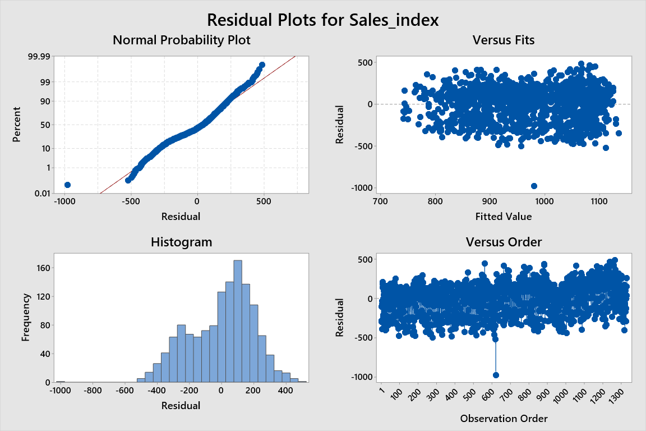
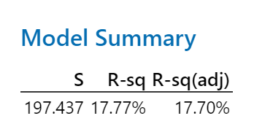
LINEAR REGRESSION Store 567

Slide 7
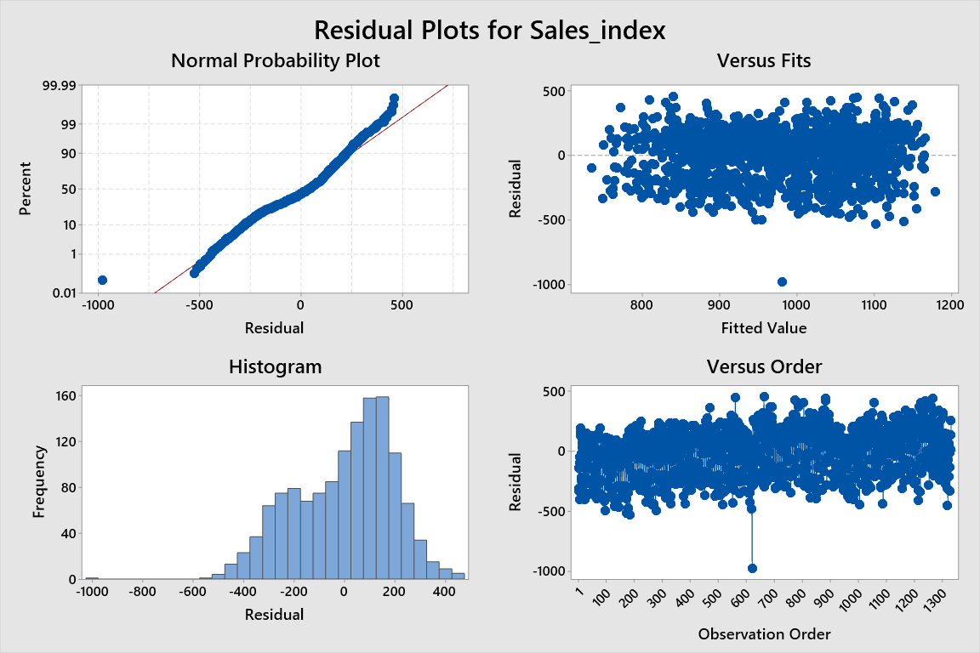
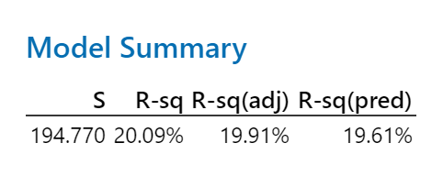
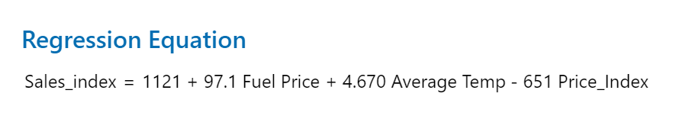
MULTI LINEAR REGRESSION Store 567

Slide 8
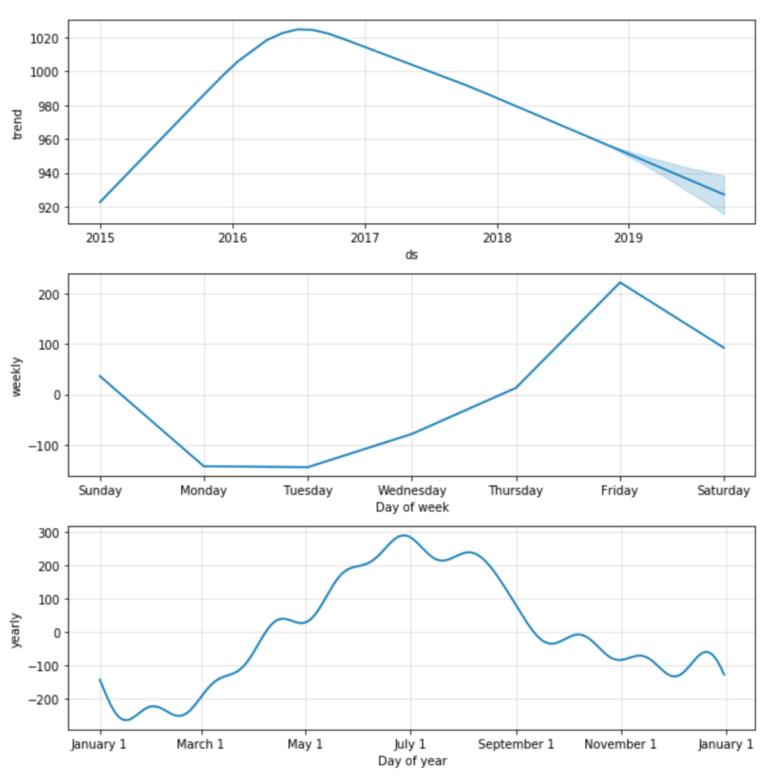
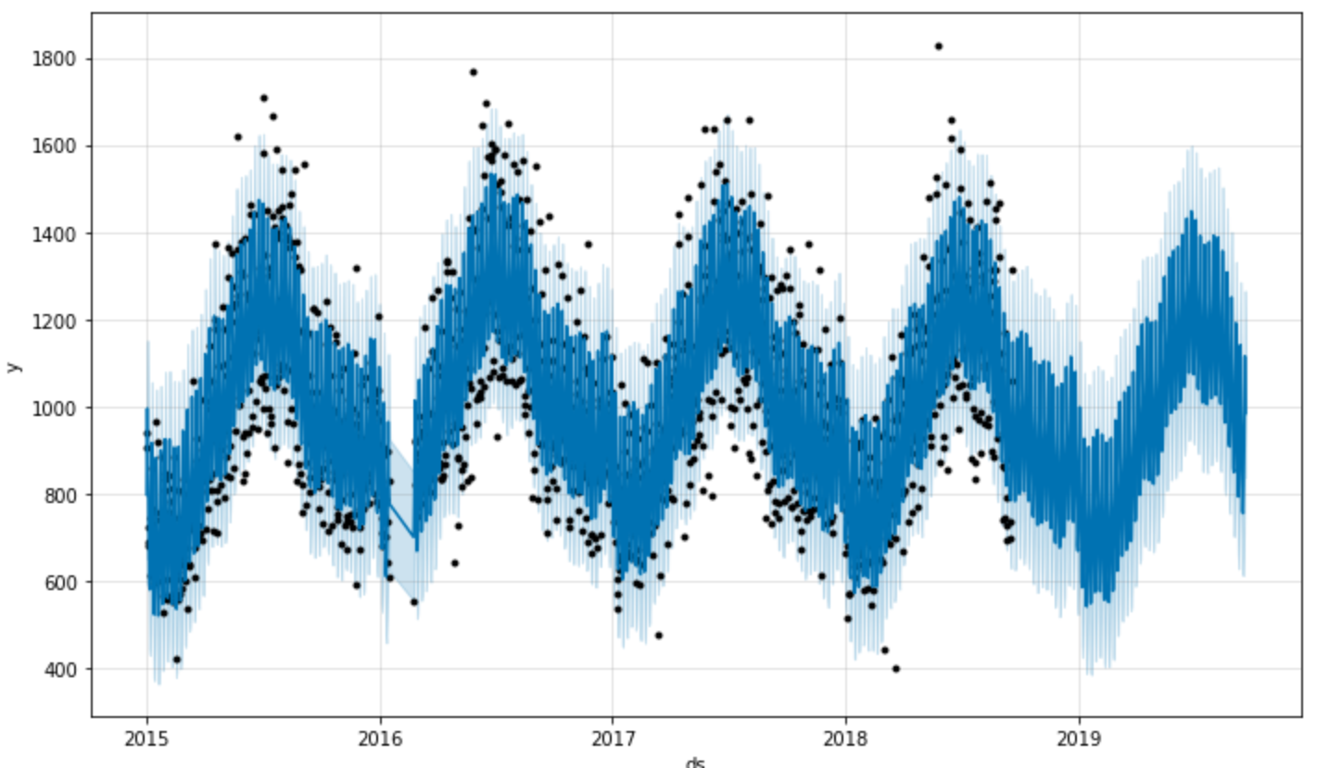
PROPHET FORECASTING Store 567

Slide 9
FUTURE-TIMELINE
MULTIPLE
REGRESSION
ENSEMBLE
APPROACH
DEEP LEARNING

Slide 10
TEAM
HARSH ANAND
RAHUL SHARMA
ATHARVA MUNGEE
Graduate Student
Graduate Student
Graduate Student
Penn State University
Penn State University
Penn State University

Slide 11
Thank You

